Slide 1
A Simple Matching Algorithm for Regular Bipartite Graphs
Kazuhisa Makino, Takashi Takabatake , Satoru Fujishige
Information Processing Letters 84 (2002) 189–193
Presenter: Mao-Yuan Kao
Date: Jun. 15, 2006

Slide 2
Abstract
We consider the perfect matching problem for a Δ-regular bipartite
graph with n vertices and m edges, and present a new
O(m + n log n logΔ) algorithm. The best existing algorithm is a
O(m) algorithm. Extending Gabow’s perfect matching
algorithm for 2^{t} -regular bipartite graph with a positive integer t and
using edge-sparsification technique, we show another approach to the
perfect matching problem, which results in a simple algorithm that
employs no sophisticated data structure such as dynamic tree and
splay tree.


Slide 3
Δ- Regular Bipartite Graph
Edge m = nΔ/2 and
|V ⁺| = |V ⁻| = |vertex|/2 = n/2
3- Regular Bipartite Graph
|Vertex| = 8
|Edge| = 8*3/2 = 12

Slide 4
Perfect Matching

Slide 5
Gabow’s Algorithm
Gabow’s algorithm [5] requires O(m) time.
However, if a given regular graph is not 2^{t} -regular for any positive integer t , the above algorithm does not work.
find a Eulerian orientation of G that consists of Eulerian tours, one for each connected component of G, and then remove those edges in G that are oriented fromV⁻ to V⁺.

Slide 6
Gabow’s Algorithm (Cont.)
if ∆ = 2^{t}
V⁻
V⁺
V⁻
V⁺
time complexity = O(m+m/2+m/4+…)
= O(m)

Slide 7
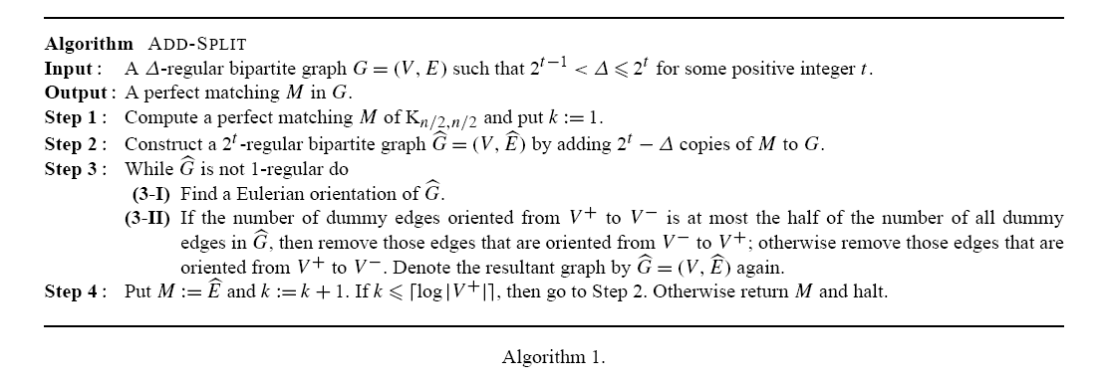
An O(m log n) Algorithm

Slide 8

An O(m log n) Algorithm (Cont.)
A 3-regular bipartite graph G = (V ,E)
such that 2^{t}−1 <Δ< 2^{t} for some positive integer t .
Construct a 2^{t} -regular bipartite graph by adding 2^{t} −Δ copies of M to G.
Compute a perfect matching M of Kn/2,n/2 and put k := 1.

Slide 9



An O(m log n) Algorithm (Cont.)
A new edge is called
dummy if there exists no edge e in E such that e and
are parallel.
the number of dummy edges
in is at most
1/2n(2^{t} − Δ) <

Slide 10

An O(m log n) Algorithm (Cont.)
Find a Eulerian orientation of
the number of dummy edges oriented fromV⁺ toV ⁻ is at most the half of the number of all dummy edges
remove those edges that
are oriented from V− to V+

Slide 11


An O(m log n) Algorithm (Cont.)
M₂
find a perfect matching M₂
M₂ has at most ¼ n (= |V⁺|/2) dummy edges. In other words, the size of the matching formed by the non-dummy edges in M₂ is at least |V⁺| − |V⁺|/2(= |V⁺|/2).
Put M := and k := k + 1.
if ,then go to Step 2. Otherwise return M and halt.

Slide 12
An O(m log n) Algorithm (Cont.)

Slide 13
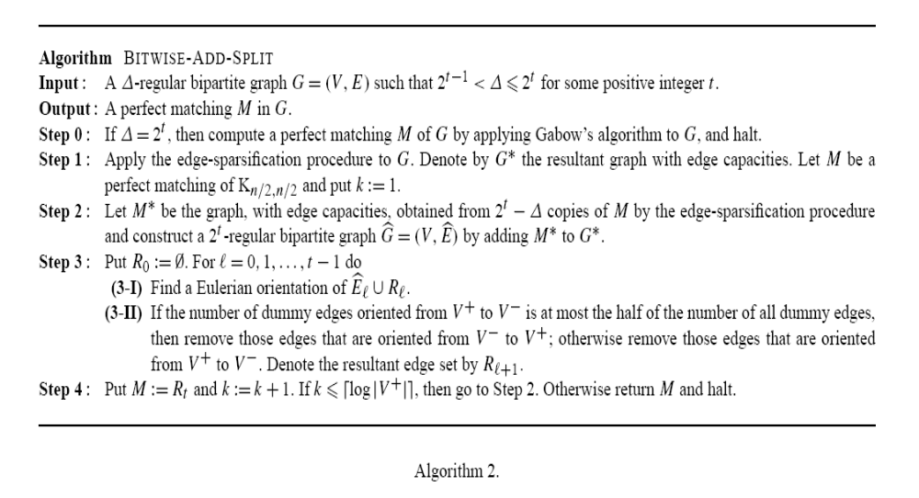
An O(m+nlognlogΔ) Algorithm

Slide 14
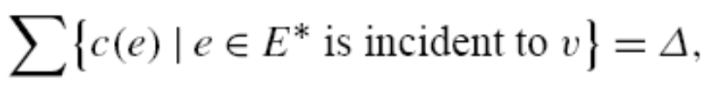
An O(m+nlognlogΔ) Algorithm (cont.)
Given a Δ-regular bipartite graph G = (V ,E) with 2^{t}−1 <Δ< 2^{t} for some
positive integer t, the edge sparsification produces a subgraph G ∗ = (V ,E∗) of
G having an edge capacity function c :E ∗ → {1, 2, 2², . . . , 2^{t} } such that
(i) for each v ∈ V , the sum of the edge capacities c(e) for all edges e incident to v is equal to Δ, i.e.,
(ii) for each l ∈ {0, 1, . . ., t}, the set of all edges e with c(e) = 2^{l}

Slide 15
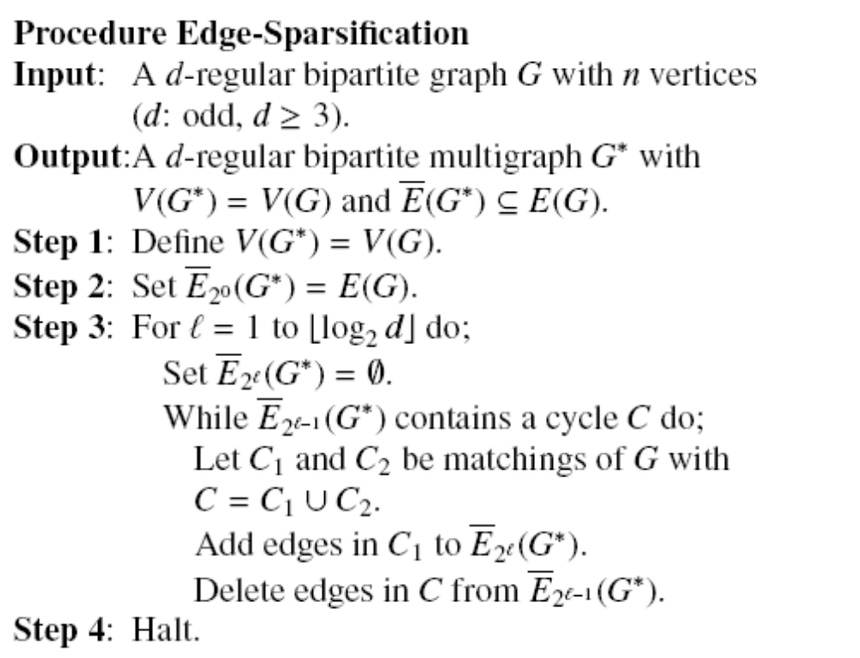
Edge Sparsification Produces
The set of edges with weight α is denoted by Eα(G).

Slide 16
An O(m+nlognlogΔ) Algorithm (cont.)
A 3-regular bipartite graph G = (V ,E)
such that 2^{t}−1 <Δ< 2^{t} for some positive integer t .
G∗ = (V ,E ∗)
Blue edge weight – 2¹
black edge weight – 2⁰

Slide 17

An O(m+nlognlogΔ) Algorithm (cont.)
Compute a Eulerian orientation of E₀ and choose those edges that are oriented from V⁺ to V⁻ (or V⁻ to V⁺).
Denote by R1 the set of such edges.
construct a 2t -regular bipartite graph
by adding M∗ to G∗.

Slide 18
An O(m+nlognlogΔ) Algorithm (cont.)
Let R₀ =∅ and
for each = 1, 2, . . ., t − 1
let R_{l} be the edge set obtained from a Eulerian orientation of
E _{l−1} ∪ R _{l−1}
R1
contains no dummy edge before we get k > log |V +|, we can output M and halt.

